Slide 1

Big Data Analytic 1

Slide 2
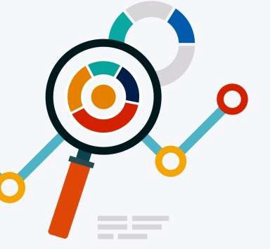
Analytics → Concept
Concept
Analytics denotes the set of methods, techniques, heuristics, and processes of analyzing data in order to find valuable information by:
Revealing hidden pattern,
Finding connections between concepts,
With this, businesses may take better/more accurate decisions.

Slide 3

Analytics → Types
Types
In Business, there are 2 generations of Analytics :
Traditional Analytics: The set of common tools of analytics that use the data in a surface as to try understanding what is going on, what is the best result, what was the set best strategy, and so forth. This kind of Analytics does not need complex methods but common practices.
Examples: Excel, Oracle, ERP, etc.
Advanced Analytics: Some traditional tools cannot process the huge volumes of Data, so more complex methods are available in statistics, mathematics, artificial intellience, etc.
Example of volumes where Excel can’t exceed thousands of rows
Traditional Analytics

Slide 4













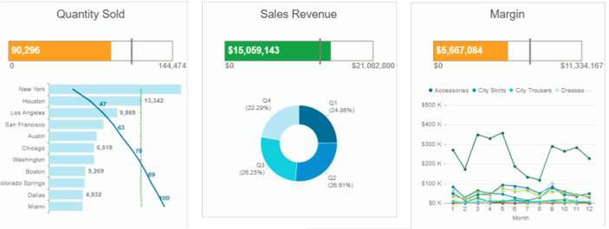












Analytics → Types → Traditional
Traditional Analytics
Business Intelligence (BI) : tools that allow business to accumulate data from internal and external sources in order to provide dashboards, and reporting for management
OnLine Analytical Processing (OLAP): tool that allows users to selectively query data from different views dynamlically.
Manufacturing
Sales
OnLine Analytical Processing (OLAP)
Business Intelligence (BI)

Slide 5

Analytics → Types → Traditional → Business Intelligence (BI)
Business Intelligence (BI)
Tools that allow business to accumulate data from internal and external sources in order to provide dashboards, and reporting for management
Business Intelligence (BI)

Slide 6





Analytics → Types → Traditional → OnLine Analytical Processing (OLAP)
OnLine Analytical Pricessing (OLAP)
Tool that allows users to selectively query data from different views dynamlically.
Manufacturing
Sales
OnLine Analytical Processing (OLAP)

Slide 7
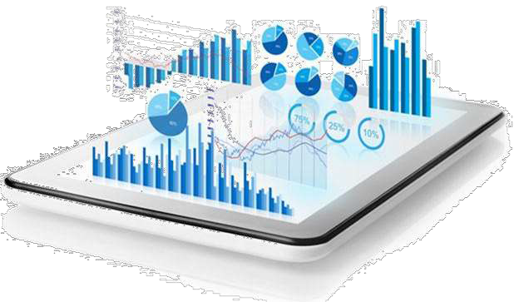

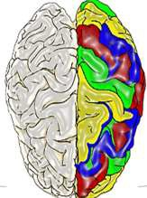
Analytics → Types → Advanced Analytics
Advanced Analytics
Artificial Intelligence : Any machine that observes the environment and decides automatically (through algorithms) to productively accomplishing goals.
Data Mining: The set of approaches that allow identifying patterns in a set of Data.
Meaningful information are extracted.
=
Data Mining
Artificial Intelligence

Slide 8
Analytics → Types → Advanced Analytics → Applicative Exercise 2
Applicative Exercise 2
Duration : 60min. Group Work. Score: 1.0
Context
Try to list more than 10 Companies that are specialized in Big Data Solutions for enterprises, with a brief description of each one, the names of the proposed products (software) and/or services (IT providing), and creation data of the activity.
Try to illustrate the evolution (history) of creation by dates and the number of companies by year in one chart. What do you have as result ?

Slide 9
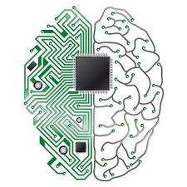
Analytics → Types → Advanced Analytics → Artificial Intelligence
Artificial Intelligence
Reasonning: By rules, logic, deductions, generalization, etc.
Knowledge representation: by gathering commonsense objects.
Multi Agent Intelligence: by planning in a shared and parallel way for the same goals
Machine Learning: algorithms that try to learn from experience to improve the present and future.
Natural Lanuguage Processing: methods that allow the machine understanding the human language
Social Intelligence: methods that allow the machine (usually set of machines) to bypass the numeric intelligence and introduce the emotional and behaivioral intelligence.
And many other types and sub-types.
=
Artificial Intelligence

Slide 10
Analytics → Types → Advanced Analytics → Data Mining
Data Mining
- Is the set of tools that aim to find hidden patterns and relationships between Data and information to answer one or more issues for an enterprise. These issues can be prediction of actions or decision making.
Data Mining

Slide 11





Analytics → Types → Advanced Analytics → Machine Learning
Machine Learning
The set of computational methods that automate the acquisition of knowledge from experience.
In Enterprises application, Machine Learning uses Statistics, Mathematics, Computer Science, and Graphs Theory in engineering tasks related to business. This provides unseen patterns and diminish irregularities in human errors
Applications in management can be:
Stock prediction,
Accounting accuracy,
Insurance Fraud detection,
Bankruptcy prediction,
Risk Prediction,
Business Process Improvement,
And many others…
Machine Learning
Data Mining
Artificial Intelligence

